Slide 1
Error Budgets, and
Introduction to Class Projects
Lecture 7, ASTR 289
Claire Max
UC Santa Cruz
January 30, 2020

Slide 2
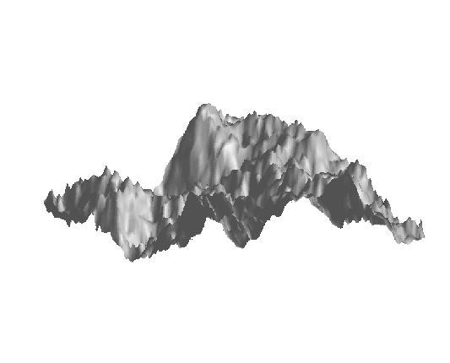
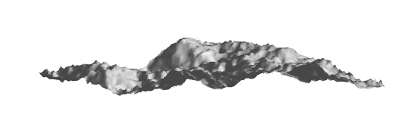
What is “residual wavefront error” ?
Science
Instrument
Telescope
AO
System
Very distorted wavefront
Less distorted wavefront
(but still not perfect)
Notes:
Crumple paper

Slide 3
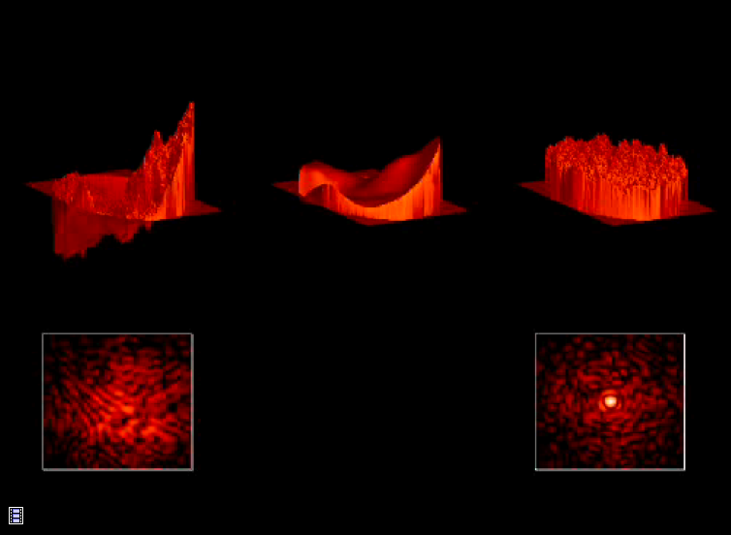
Incident wavefront
Shape of
Deformable Mirror
Corrected wavefront
Image of point source
Image of point source
Credit: James Lloyd, Cornell Univ.

Slide 4
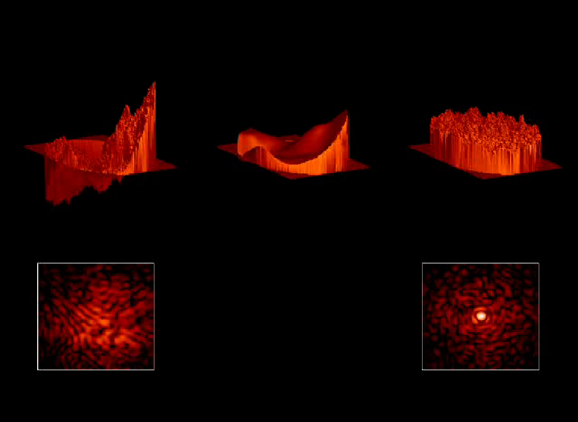

Slide 5
Units of wavefront error
Electromagnetic wave propagation
Change in phase due to variation in index of refraction n
Can express as:
  Phase Φ ~ kΔx = k₀nΔx (units: radians)
  Optical path difference Φ/k = Δx (units: length)
    Frequently microns or nanometers
  Waves: Δx / λ (units: dimensionless)

Slide 6
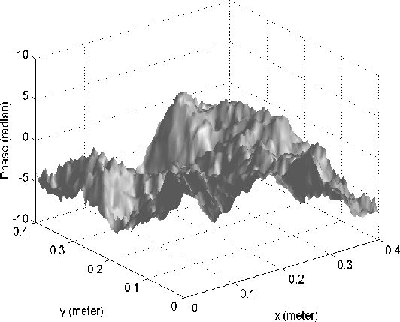
How to calculate residual wavefront error
Optical path difference = Δz where k Δz is the phase change due to turbulence
Phase variance is σ² = <(k Δz)² >
If several independent effects cause changes in the phase,
Sum up the contributions from individual physical effects independently

Slide 7
An error budget can describe wavefront phase or optical path difference
Be careful of units (Hardy and I will both use a variety of units in error budgets):
  For tip-tilt residual errors: variance of tilt angle <α²>
  Optical path difference nΔz in meters: OPD_{m}
  Optical path difference nΔz in waves: OPD_{λ} = nΔz / λ
  Optical path difference in radians of phase:
    ϕ = 2π OPD_{λ} = (2π/λ) OPD_{m} = k OPD_{m}

Slide 8
Question
If the total wavefront error is
σ_{tot}² = σ₁² + σ₂² + σ₃² + ...
List as many physical effects as you can think of that might contribute to the overall wavefront error σ_{tot}²

Slide 9
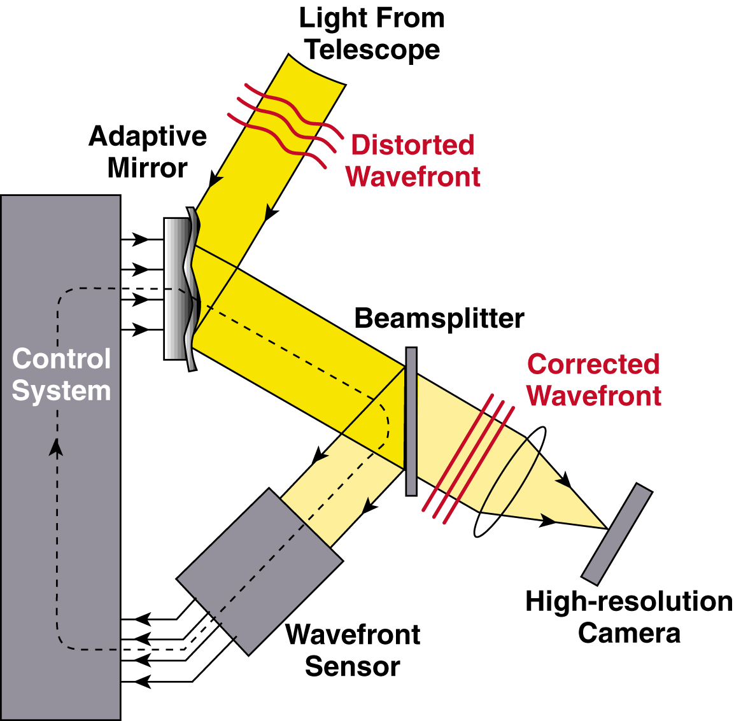
Elements of an adaptive optics system

Slide 10
Elements of an adaptive optics system
Deformable mirror fitting error
Not shown: tip-tilt error, anisoplanatism error
temporal delay, noise propagation
Non-common path errors
Measurement error

Slide 11
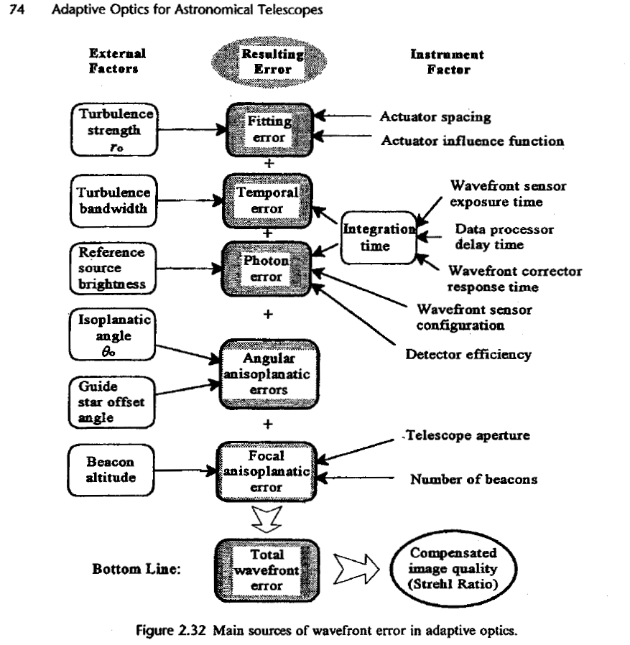
Hardy
Figure 2.32

Slide 12
What is an “error budget” ?
The allocation of statistical variations and/or error rates to individual components of a system, in order to satisfy the full system's end-to-end performance specifications.
The term “error budget” is a bit misleading: it doesn’t mean “error” as in “mistake” - it means performance uncertainties, and/or the imperfect, “real life” performance of each component in the system.
In a new project: Start with “top down” performance requirements from the science that will be done. Allocate “errors” to each component to satisfy overall requirements. As design proceeds, replace “allocations” with real performance of each part of system. Iterate.

Slide 13
Wavefront errors due to time lags, τ₀
Wavefront phase variance due to τ₀
  If an AO system corrects turbulence “perfectly” but with a phase lag characterized by a time τ, then
The factor of 28.4 out front is a significant penalty: have to run AO system a lot faster than τ = τ₀
For σ_{τ}² < 1, τ < 0.13 τ₀
In addition, closed-loop bandwidth is usually ~ 10x sampling frequency ⇒ have to run even faster
Hardy Eqn 9.57

Slide 14
Wavefront variance due to isoplanatic angle θ₀
If an AO system corrects turbulence “perfectly” but uses a guide star at an angle θ away from the science target,
Typical values of θ₀ are a few arc sec at λ = 0.5 μm,
15-20 arc sec at λ = 2 μm
Hardy Eqn 3.104

Slide 15
Deformable mirror fitting error
Accuracy with which a deformable mirror with subaperture diameter d can remove wavefront aberrations
With a finite number of actuators, you can’t do a perfect fit to an arbitrary wavefront
Constant μ depends on specific design of deformable mirror
For segmented mirror that corrects tip, tilt, and piston (3 degrees of freedom per segment) μ = 0.14
For deformable mirror with continuous face-sheet, μ = 0.28

Slide 16
Error budget concept (sum of σ² ’s)
There’s not much to be gained by making any particular term much smaller than all the others: try to roughly equalize all the terms
Individual terms we know so far:
  Anisoplanatism
  Temporal error
  Fitting error

Slide 17
We will discuss other wavefront error terms in coming lectures
Measurement error
  Wavefront sensor doesn’t make perfect measurements
  Finite signal to noise ratio, optical limitations, …
Non-common-path errors
  Calibration of different optical paths between science instrument and wavefront sensor isn’t perfect
Calibration errors
  What deformable mirror shape would correspond to a perfectly flat wavefront?
Tip-Tilt errors
  Need to rephrase these in terms of wavefront error rather than angle of arrival variance

Slide 18
Error budget so far
√
√
√
Still need to work these out
Try to “balance” error terms: if one is big,
no point struggling to make the others tiny

Slide 19
Keck AO error budget example (not current)
Assumptions:
Natural guide star is very bright (no measurement error)
10 degree zenith angle
Wavefront sensor bandwidth: 670 Hz
Note that uncorrectable errors in telescope itself are significant

Slide 20
We want to relate phase variance <σ²> to the “Strehl ratio”
Two definitions of Strehl ratio (equivalent):
  Ratio of the maximum intensity of a point spread function to what the maximum would be without any aberrations:
  The “normalized volume” under the optical transfer function of an aberrated optical system

Slide 21
Relation between phase variance and Strehl ratio
“Maréchal Approximation”
  where σ_{ϕ}² is the total wavefront variance
  Valid when Strehl > 10% or so
  Under-estimates the Strehl for low-Strehl situations (larger values of σ_{ϕ}² )

Slide 22
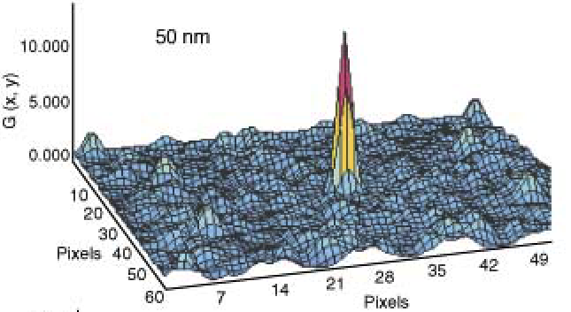
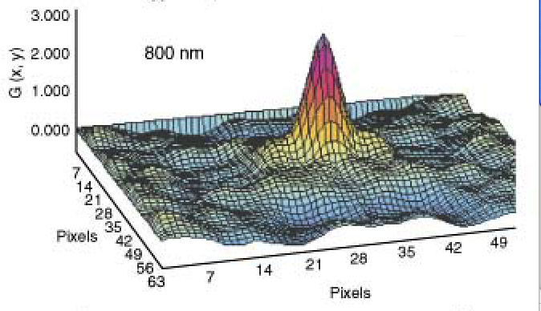
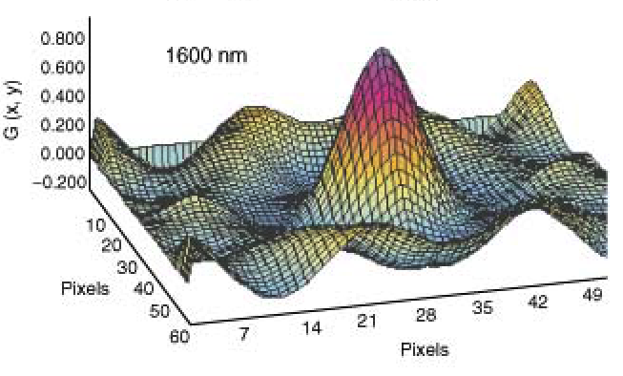
High Strehl PSF with higher peak intensity and narrower “core”
High
Strehl
Low
Strehl
Medium
Strehl

Slide 23
Summary of topics discussed today
Wavefront errors due to:
  Timescale of turbulence
  Isoplanatic angle
  Deformable mirror fitting error
  Other effects
Concept of an “error budget”
Goal: to calculate <σ_{ϕ}²> and thus the Strehl ratio

